Slide 1
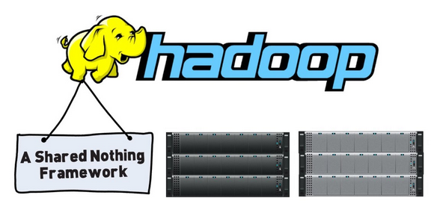
Cloud Programming and Software Environments
Map Reduce and Hadoop
Adapted from Kai Hwang, University of Southern California with additions from Matei Zaharia, EECS, UC Berkeley

Slide 2
Overview
Process flow in MapReduce
Motivation for Programming Paradigm
MapReduce
MapReduce Operational Steps
Twister : Iterative MapReduce
Hadoop
HDFS Architecture
Read and Write Operations in HDFS
MapReduce Architecture in Hadoop
Running a job in Hadoop
Challenges

Slide 3
Parallel Computing and Programming Paradigms Process Flow in MapReduce
Partitioning
Computation Partitioning: This splits a given job or a program into smaller tasks. Partitioning greatly depends on correctly identifying portions of the job or program that can be performed concurrently.
Data Partitioning: This splits the input or intermediate data into smaller pieces.
Mapping (Resource Allocator): This process aims to appropriately assign smaller parts of data and pieces of program to be run simultaneously on different workers and is usually handled by resource allocators in the system
Synchronization: Because different workers may perform different tasks, synchronization and coordination among workers is necessary so that race conditions are prevented and data dependency among different workers is properly managed
Communication: Because data dependency is one of the main reasons for communication among workers, communication is always triggered when the intermediate data is sent to workers
Scheduling (Resource Allocator and Scheduler): For a job or program, when the number of computation parts (tasks) or data pieces is more than the number of available workers, a scheduler selects a sequence of tasks or data pieces to be assigned to the workers.

Slide 4
Motivation for Programming Paradigm
To improve productivity for programmers
To decrease programs time to market
To leverage underlying resources more efficiently
To increase system throughput
To support higher levels of abstraction
MapReduce, Hadoop and Dryad are parallel and distributed programming models.

Slide 5
What is MapReduce?
Simple data-parallel programming model
For large-scale data processing
Exploits large set of commodity computers
Executes process in distributed manner
Offers high availability
Pioneered by Google
Processes 20 petabytes of data per day
Popularized by open-source Hadoop project
Used at Yahoo!, Facebook, Amazon, …

Slide 6
What is MapReduce used for?
At Google:
Index construction for Google Search
Article clustering for Google News
Statistical machine translation
At Yahoo!:
“Web map” powering Yahoo! Search
Spam detection for Yahoo! Mail
At Facebook:
Data mining
Ad optimization
Spam detection

Slide 7
Motivation: Large Scale Data Processing
Many tasks composed of processing lots of data to produce lots of other data
Want to use hundreds or thousands of CPUs ... but this needs to be easy!
Map Reduce provides
User-defined functions
Automatic parallelization and distribution
Fault-tolerance
I/O scheduling
Status and monitoring

Slide 8
What is MapReduce used for?
In research:
Astronomical image analysis (Washington)
Bioinformatics (Maryland)
Analyzing Wikipedia conflicts (PARC)
Natural language processing (CMU)
Particle physics (Nebraska)
Ocean climate simulation (Washington)
<Your application here>

Slide 9
Map Reduce Architecture
Master node
user
Job tracker
Slave node 1
Slave node 2
Slave node N
Task tracker
Task tracker
Task tracker
Workers
Workers
Workers

Slide 10
Map+Reduce
Map:
Accepts input key/value pair
Emits intermediate key/value pair
Reduce :
Accepts intermediate key/value* pair
Emits output key/value pair
R
E
D
U
C
E
Very
big
data
M
A
P
Partitioning
Function
Result

Slide 11
Functions in the Model
Map
Process a key/value pair to generate intermediate key/value pairs
Reduce
Merge all intermediate values associated with the same key
Partition
By default : hash(key) mod R
Well balanced

Slide 12
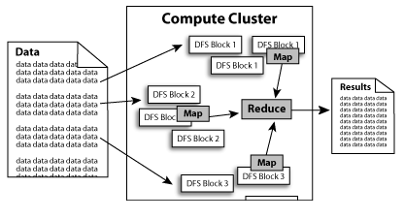

Slide 13
MapReduce
Cat
Bat
Dog
Other
Words
(size:
TByte)
combine
reduce
map
part0
split
reduce
combine
split
map
part1
combine
reduce
split
map
part2
split
map

Slide 14
A Simple Example
Counting words in a large set of documents
map(string value)‏
//key: document name
//value: document contents
for each word w in value
EmitIntermediate(w, “1”);
reduce(string key, iterator values)‏
//key: word
//values: list of counts
int results = 0;
for each v in values
result += ParseInt(v);
Emit(AsString(result));
The map function emits each word w plus an associated count of occurrences (just a “1” is recorded in this pseudo-code)
The reduce function sums together all counts emitted for a particular word

Slide 15
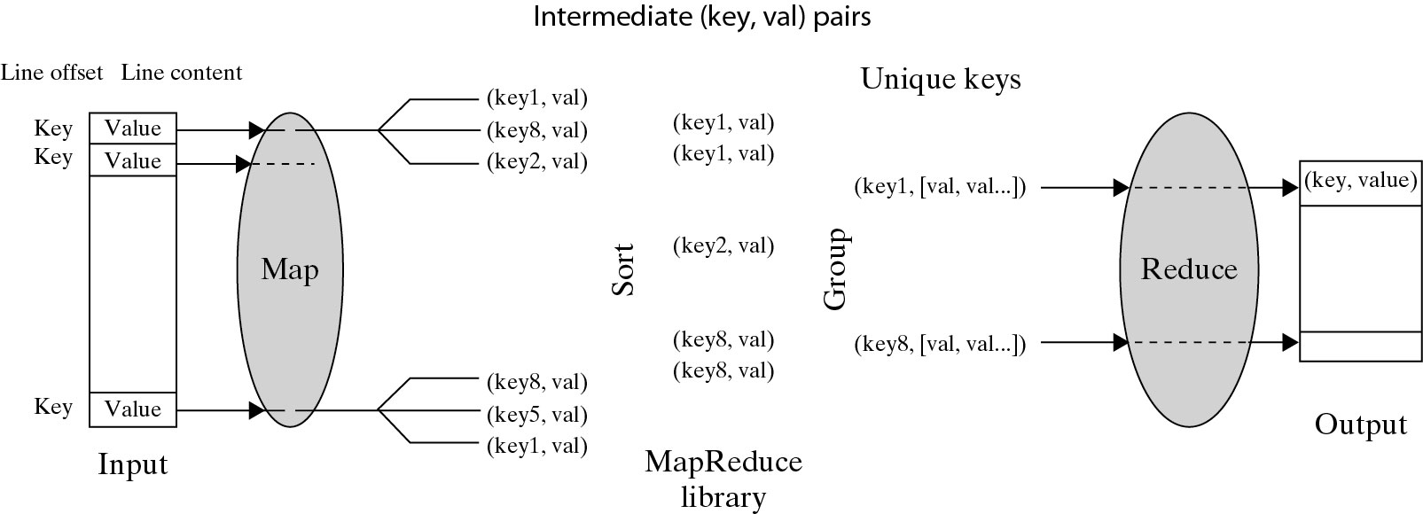
Logical Data Flow in 5 Processing Steps in MapReduce Process
(Key, Value) Pairs are generated by the Map function over multiple available Map Workers (VM instances). These pairs are then sorted and group based on key ordering. Different key-groups are then processed by multiple Reduce Workers in parallel.
Notes:
Cloud applications are the key global opportunity for developers during next four years
2009: $8.5 billion
2013: $16.8 billion

Slide 16
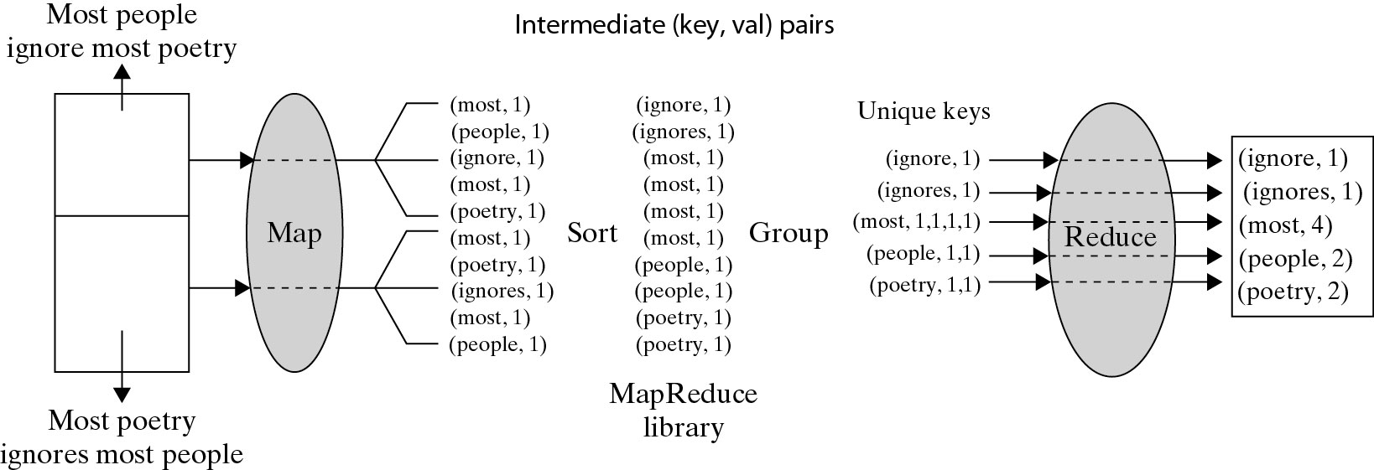
A Word Counting Example on <Key, Count> Distribution
Notes:
Cloud applications are the key global opportunity for developers during next four years
2009: $8.5 billion
2013: $16.8 billion

Slide 17
Actual MapReduce Data and Control Flow
Data Partitioning
Computation Partitioning
Determining Master and workers
Reading Input data (Data Distribution)
Map Function
Combiner Function
Partitioning Function
Synchronization
Communication
Sorting and Grouping
Reduce Function
Mapper
Reducer

Slide 18
Actual MapReduce Data and Control Flow
Data Partitioning: The MapReduce library splits the input data (files), already stored in GFS, into M pieces that also correspond to the number of map tasks.
Computation Partitioning: MapReduce library only generates copies of a user program (e.g., by a fork system call) containing the Map and the Reduce functions, distributes them, and starts them up on a number of available computation engines.
Determining Master and workers: The MapReduce architecture is based on a master-worker model. Therefore, one of the copies of the user program becomes the master and the rest become workers. The master picks idle workers, and assigns the map and reduce tasks to them.
Mapper Functions
Reading Input data (Data Distribution) : Each map worker reads its corresponding portion of the input data split and sends it to its Map function
Map Function : Each Map function receives the input data split as a set of (key, value) pairs to process and produce the intermediated (key, value) pairs.
Combiner Function: The Combiner function merges the local data of each map worker before sending it over the network to effectively reduce its communication costs
Partitioning Function : The intermediate (key, value) pairs with identical keys are grouped together because all values inside each group should be processed by only one Reduce function to generate the final result. Intermediate (key, value) pairs are partitioned into R regions, equal to the number of reduce tasks by Partitioning Function. A Partitioning function could simply be a hash function (e.g., Hash(key) mod R) that forwards the data into particular regions.

Slide 19
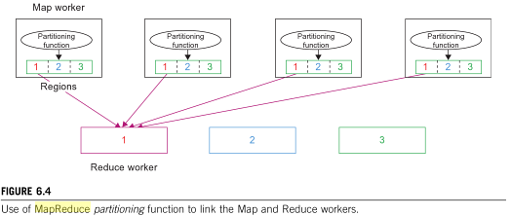
MapReduce Partitioning Function

Slide 20
Actual MapReduce Data and Control Flow
Synchronization: MapReduce applies a simple synchronization policy to coordinate map workers with reduce workers, in which the communication between them starts only when all map tasks finish.
Communication: Reduce worker i, already notified of the location of region i of all map workers, uses a remote procedure call to read the data from the respective region of all map workers.
Reduce Function
Sorting and Grouping: Reduce worker groups intermediate (key, value) pairs by sorting the data based on their keys, followed by grouping all occurrences of identical keys.
Reduce Function: The reduce worker iterates over the grouped (key, value) pairs, and for each unique key, it sends the key and corresponding values to the Reduce function. Reduce function processes its input data and stores the output results in predetermined files in the user’s program.

Slide 21
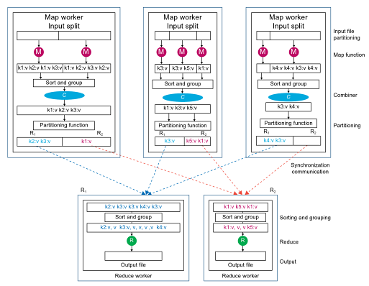
Data Flow of MapReduce
Notes:
Cloud applications are the key global opportunity for developers during next four years
2009: $8.5 billion
2013: $16.8 billion

Slide 22
Points need to be emphasized
No reduce can begin until map is complete
Master must communicate locations of intermediate files
Tasks scheduled based on location of data
If map worker fails any time before reduce finishes, task must be completely re-run
MapReduce library does most of the hard work for us!

Slide 23
Locality issue
Master scheduling policy
Asks GFS for locations of replicas of input file blocks
Map tasks typically split into 64MB (== GFS block size)
Map tasks scheduled so that GFS input block replica are on same machine or same rack
Effect
Thousands of machines read input at local disk speed
Without this, rack switches limit read rate

Slide 24
Fault Tolerance
Reactive way
Worker failure
Heartbeat, Workers are periodically pinged by master
NO response = failed worker
If the processor of a worker fails, the tasks of that worker are reassigned to another worker.
Master failure
Master writes periodic checkpoints
Another master can be started from the last checkpointed state
If eventually the master dies, the job will be aborted

Slide 25
Fault Tolerance
Proactive way (Redundant Execution)
When computation almost done, reschedule in-progress tasks
Whenever either the primary or the backup executions finishes, mark it as completed
The problem of “stragglers” (slow workers)
Other jobs consuming resources on machine
Bad disks with soft errors transfer data very slowly
Weird things: processor caches disabled (!!)

Slide 26
Fault Tolerance
Input error: bad records
Map/Reduce functions sometimes fail for particular inputs
Best solution is to debug & fix, but not always possible
On segment fault
Send UDP packet to master from signal handler
Include sequence number of record being processed
Skip bad records
If master sees two failures for same record, next worker is told to skip the record

Slide 27



MapReduce Implementations
MapReduce
Cluster,
1, Google
2, Apache Hadoop
Multicore CPU,
Phoenix @ stanford
GPU,
Mars@HKUST

Slide 28
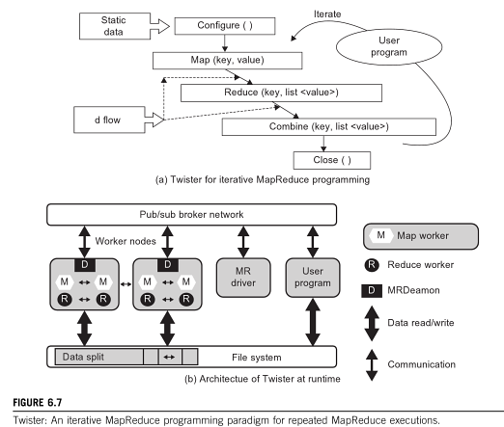
Twister for Iterative MapReduce

Slide 29
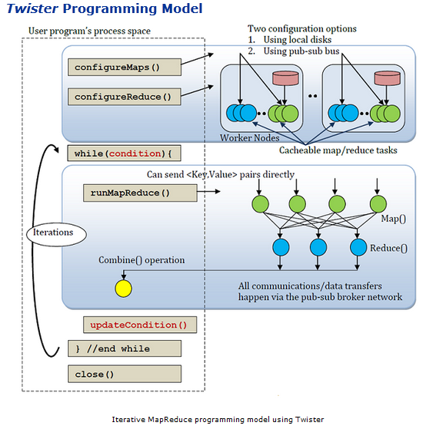
Twister for Iterative MapReduce

Slide 30
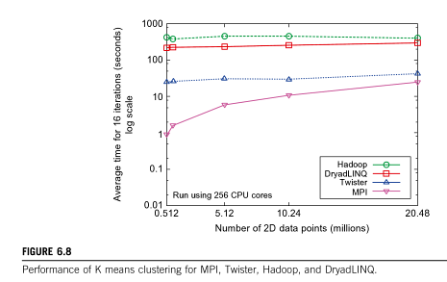
Performance of Parallel Programming Models

Slide 31
Hadoop MapReduce
Hadoop is an open source implementation of MapReduce coded and released in Java by Apache.
Hadoop implementation uses Hadoop Distributed File System.
Hadoop core is divided into two layers.
MapReduce Engine as computation engine
HDFS as data storage manager.
HDFS is inspired by GFS, it organizes files and stores data in distributed computing system.

Slide 32
Hadoop MapReduce
Hadoop : software platform originally developed by Yahoo enabling users to write and run applications over vast distributed data.
Attractive Features in Hadoop :
Scalable : can easily scale to store and process petabytes of data in the Web space
Economical : An open-source MapReduce minimizes the overheads in task spawning and massive data communication.
Efficient: Processing data with high-degree of parallelism across a large number of commodity nodes
Reliable : Automatically maintains multiple copies of data to facilitate redeployment of computing tasks on failures

Slide 33
Basic Features of a File System
A Distributed File system must provide the following features
Performance
Scalability
Concurrency control
Fault Tolerance
Security requirements

Slide 34
Basic Features: HDFS
Highly fault-tolerant
High throughput
Suitable for applications with large data sets
Streaming access to file system data
Can be built out of commodity hardware
Security is not supported by HDFS

Slide 35
Fault tolerance
Failure is the norm rather than exception
A HDFS instance may consist of thousands of server machines, each storing part of the file system’s data.
Since we have huge number of components and that each component has non-trivial probability of failure means that there is always some component that is non-functional.
Detection of faults and quick, automatic recovery from them is a core architectural goal of HDFS.

Slide 36
Streaming Data
Streaming access enables data to be transferred in the form of a steady and continuous stream.
This means if data from a file in HDFS needs to be processed, HDFS starts sending the data as it reads the file and does not wait for the entire file to be read.
The client who is consuming this data starts processing the data immediately, as it receives the stream from HDFS.
This makes data processing really fast

Slide 37
Data Characteristics
Streaming data access
Applications need streaming access to data
Batch processing rather than interactive user access.
Large data sets and files: gigabytes to terabytes size
High aggregate data bandwidth
Scale to hundreds of nodes in a cluster
Tens of millions of files in a single instance
Write-once-read-many: a file once created, written and closed need not be changed – this assumption simplifies coherency. No Data Appending as in GFS
A map-reduce application or web-crawler application fits perfectly with this model.

Slide 38
Architecture of HDFS

Slide 39
Namenode and Datanodes
Master/slave architecture
HDFS cluster consists of a single Namenode, a master server that manages the file system namespace, Metadata and regulates access to files by clients.
There are a number of DataNodes usually one per node in a cluster.
The DataNodes manage storage attached to the nodes that they run on.
HDFS exposes a file system namespace and allows user data to be stored in files.
A file is split into one or more blocks and set of blocks are stored in DataNodes.
DataNodes: serves read, write requests, performs block creation, deletion, and replication upon instruction from Namenode.

Slide 40
HDFS Architecture
Namenode
Metadata(Name, replicas..)
(/home/foo/data,6. ..
Metadata ops
Client
Block ops
Read
Datanodes
Datanodes
B
replication
Blocks
Rack1
Write
Rack2
Client

Slide 41
File system Namespace
Hierarchical file system with directories and files
Create, remove, move, rename etc.
Namenode maintains the file system
Any meta information changes to the file system recorded by the Namenode.
An application can specify the number of replicas of the file needed: replication factor of the file. This information is stored in the Namenode.

Slide 42
Data Replication
HDFS is designed to store very large files across machines in a large cluster.
Each file is a sequence of blocks.
All blocks in the file except the last are of the same size.
Blocks are replicated for fault tolerance.
Block size and replicas are configurable per file.
The Namenode receives a Heartbeat and a BlockReport from each DataNode in the cluster.
Heartbeat implies that the DataNode is functioning properly
BlockReport contains list of all the blocks on a Datanode.

Slide 43
Replica Placement
The placement of the replicas is critical to HDFS reliability and performance.
Optimizing replica placement distinguishes HDFS from other distributed file systems.
Rack-aware replica placement:
Goal: improve reliability, availability and network bandwidth utilization
Research topic
Many racks, communication between racks are through switches.
Network bandwidth between machines on the same rack is greater than those in different racks.
Namenode determines the rack id for each DataNode.
Replicas are typically placed on unique racks
Simple but non-optimal
Writes are expensive
Replication factor is 3
Another research topic?
Replicas are placed: one on a node in a local rack, one on a different node in the local rack and one on a node in a different rack.
1/3 of the replica on a node, 2/3 on a rack and 1/3 distributed evenly across remaining racks.

Slide 44
Replica Selection
Replica selection for READ operation: HDFS tries to minimize the bandwidth consumption and latency.
If there is a replica on the Reader node then that is preferred.
HDFS cluster may span multiple data centers: replica in the local data center is preferred over the remote one.

Slide 45
Writing a file into HDFS
Writing files in HDFS
The client informs the namenode daemon that it wants to write a file. The namenode daemon checks to see whether the file already exists.
If it exists, an appropriate message is sent back to the client. If it does not exist, the namenode daemon makes a metadata entry for the new file.
The file to be written is split into data packets at the client end and a data queue is built. The packets in the queue are then streamed to the datanodes in the cluster.
The list of datanodes is given by the namenode daemon, which is prepared based on the data replication factor configured. A pipeline is built to perform the writes to all datanodes provided by the namenode daemon.
The first packet from the data queue is then transferred to the first datanode daemon. The block is stored on the first datanode daemon and is then copied to the next datanode daemon in the pipeline. This process goes on till the packet is written to the last datanode daemon in the pipeline.
The sequence is repeated for all the packets in the data queue. For every packet written on the datanode daemon, a corresponding acknowledgement is sent back to the client.
If a packet fails to write onto one of the datanodes, the datanode daemon is removed from the pipeline and the remainder of the packets is written to the good datanodes. The namenode daemon notices the under-replication of the block and arranges for another datanode daemon where the block could be replicated.
After all the packets are written, the client performs a close action, indicating that the packets in the data queue have been completely transferred.
The client informs the namenode daemon that the write operation is now complete.

Slide 46
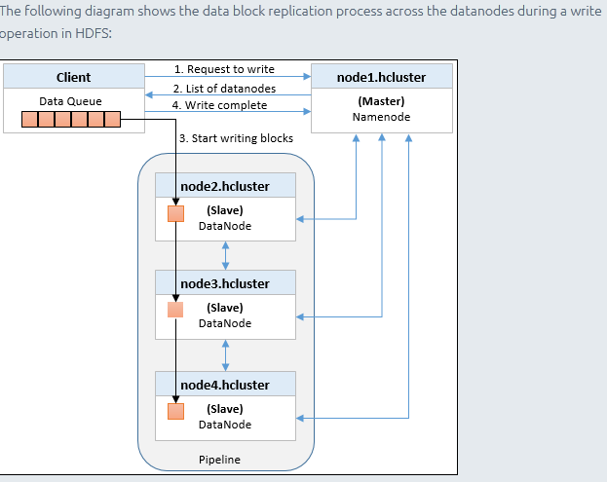
Writing Data into HDFS

Slide 47
Reading a file from HDFS
Reading files from HDFS
The client contacts the namenode daemon to get the location of the data blocks of the file it wants to read.
The namenode daemon returns the list of addresses of the datanodes for the data blocks.
For any read operation, HDFS tries to return the node with the data block that is closest to the client. Here, closest refers to network proximity between the datanode daemon and the client.
Once the client has the list, it connects the closest datanode daemon and starts reading the data block using a stream.
After the block is read completely, the connection to datanode is terminated and the datanode daemon that hosts the next block in the sequence is identified and the data block is streamed. This goes on until the last data block for that file is read.

Slide 48
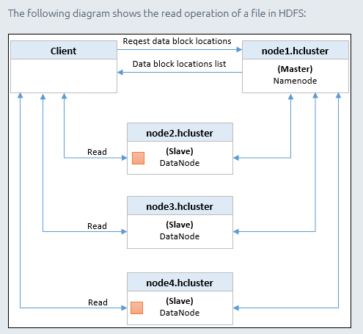
Reading Data from HDFS

Slide 49
Architecture of Hadoop

Slide 50
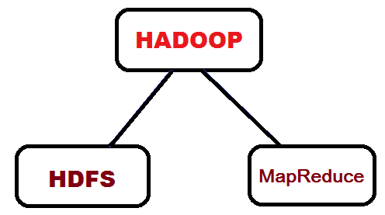
Hadoop Architecture

Slide 51
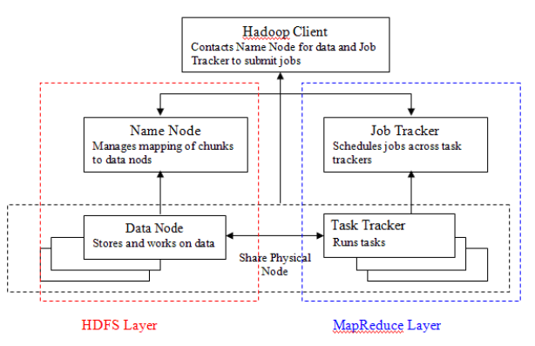
Hadoop Architecture

Slide 52
Hadoop Components
Distributed file system (HDFS)
Single namespace for entire cluster
Replicates data 3x for fault-tolerance
MapReduce framework
Executes user jobs specified as “map” and “reduce” functions
Manages work distribution & fault-tolerance

Slide 53
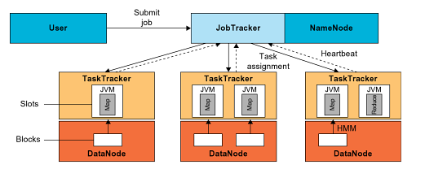
Hadoop Architecture

Slide 54
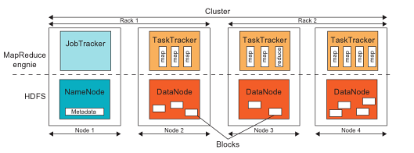
HDFS and MapReduce in Hadoop
Notes:
Cloud applications are the key global opportunity for developers during next four years
2009: $8.5 billion
2013: $16.8 billion

Slide 55
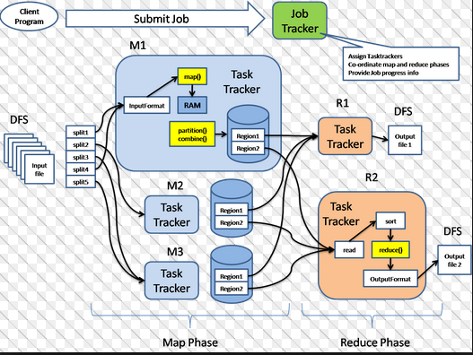
Hadoop Architecture

Slide 56
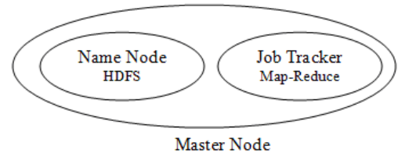
Hadoop Architecture
These functions are handled by two different nodes:
Name Node: helps in coordinating HDFS
Job Tracker: helps in coordinating parallel execution of Map-Reduce

Slide 57
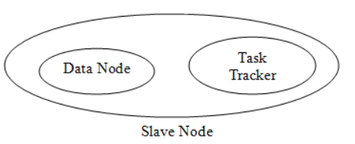
Hadoop Architecture
Slave node consists of Data Node and Task Tracker.
There are number slave nodes in a Hadoop cluster.
These nodes communicate and receive instructions for the Master nodes and perform the assigned tasks.

Slide 58
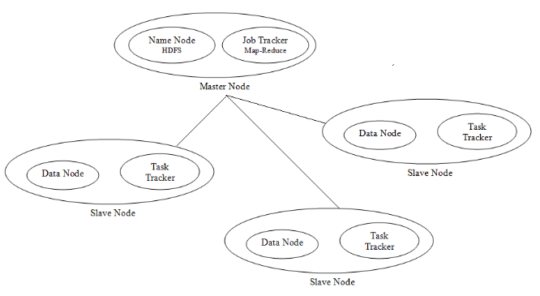
Hadoop Architecture

Slide 59
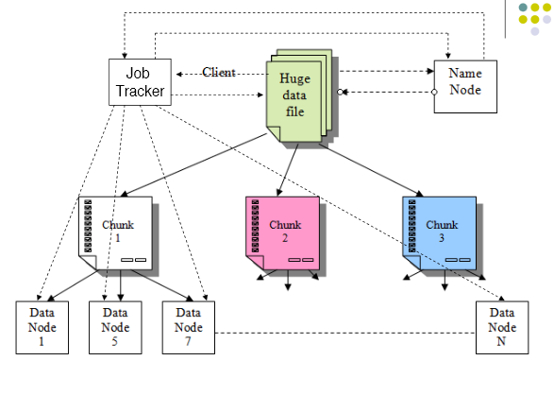
Hadoop Working

Slide 60
Name Node and Data Node
Name Node is a critical component of the HDFS.
Responsible for the distribution of the data throughout the Hadoop cluster.
Obtains the data from client machine divides it in to chunks.
Distributes same data chunk to three different data nodes leading to data redundancy
Keeps track of What chucks belong to a file and which Data Node holds its copy.
Making sure each chunk of file has the minimum number of copies in the cluster as required.
Directs clients for write or read operation
Schedule and execute Map Reduce jobs
One slave act as secondary NameNode
Data Node
Responsible to store the chunk of data that assigned to it by the Name Node.

Slide 61
Job Tracker and Task Tracker
Job Tracker
Client submitted Map-Reduce logic.
Responsible for scheduling the task to the slave nodes.
Job Tracker consults the Name Node and assigns the task to the nodes which has the data on which this task would be performed
Locality of data is checked for assigning a Map function to a node (Task Tracker), whereas Reduce function does not need locality of data.
One Task Tracker may act as secondary Job Tracker
Task Tracker
Has the actual logic to perform the task.
Performs the task (Map and reduce functions) on the data assigned to it by Master Node.

Slide 62
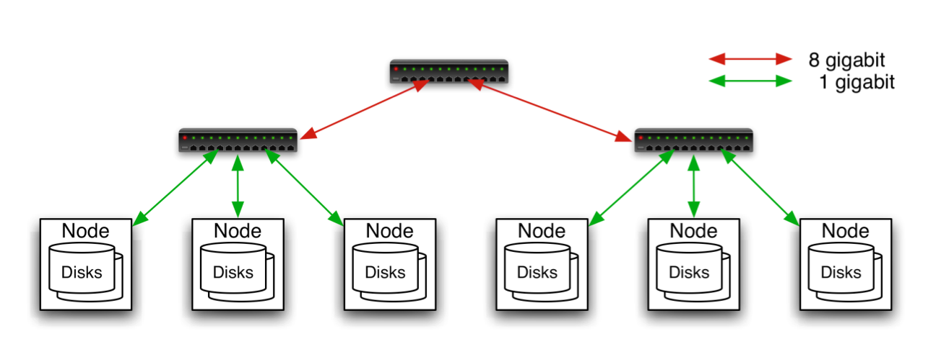
Typical Hadoop Cluster
Aggregation switch
Rack switch
40 nodes/rack, 1000-4000 nodes in cluster
1 Gbps bandwidth within rack, 8 Gbps out of rack
Node specs (Yahoo terasort): 8 x 2GHz cores, 8 GB RAM, 4 disks (= 4 TB?)
Image from http://wiki.apache.org/hadoop-data/attachments/HadoopPresentations/attachments/YahooHadoopIntro-apachecon-us-2008.pdf

Slide 63
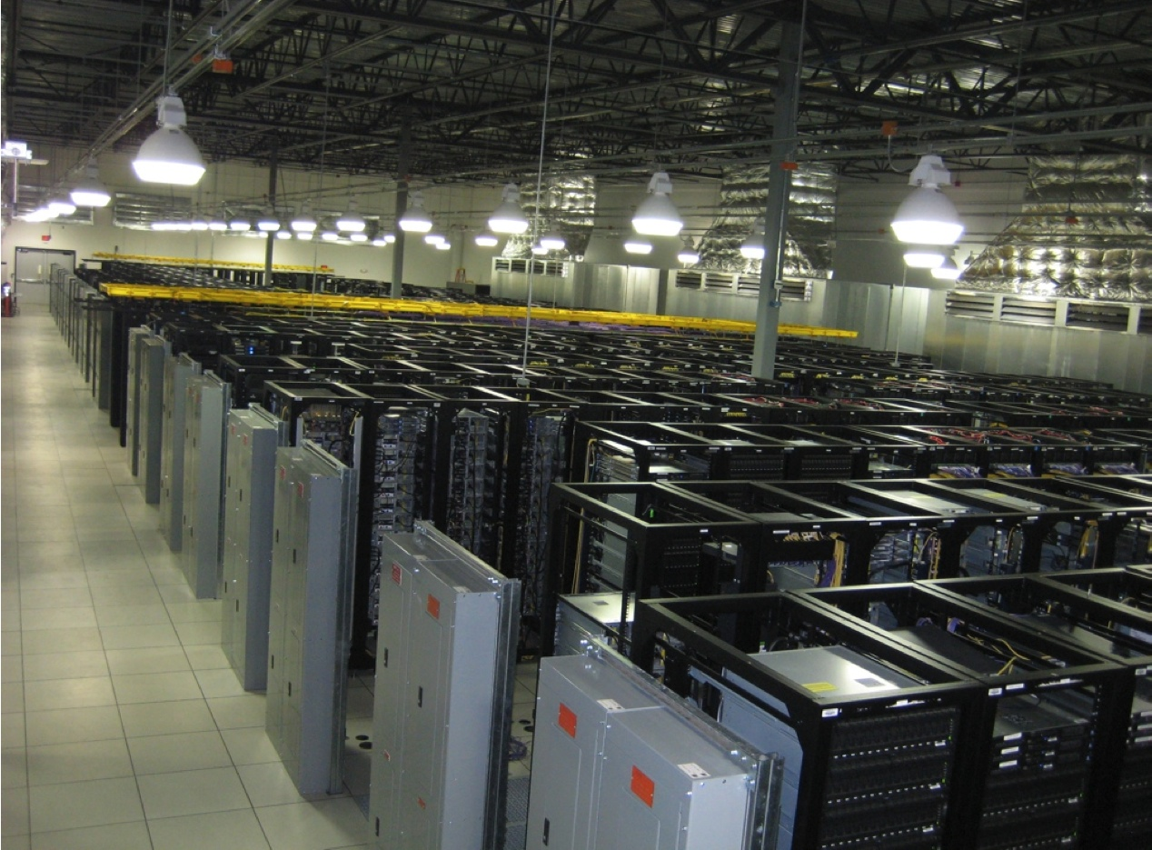
Typical Hadoop Cluster
Image from http://wiki.apache.org/hadoop-data/attachments/HadoopPresentations/attachments/aw-apachecon-eu-2009.pdf

Slide 64
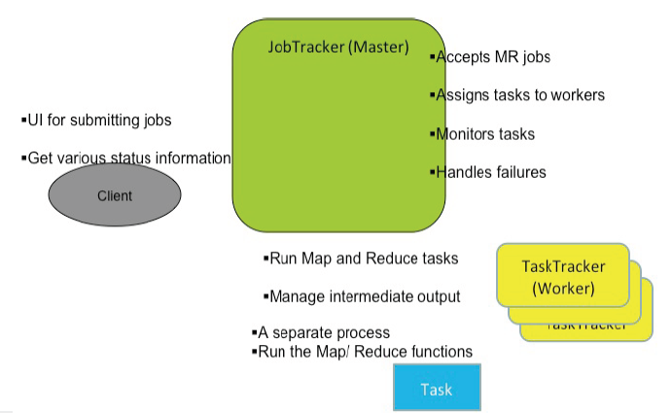
MapReduce Architecture

Slide 65
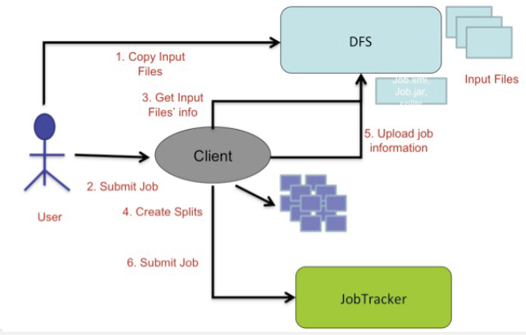
Job Submission

Slide 66
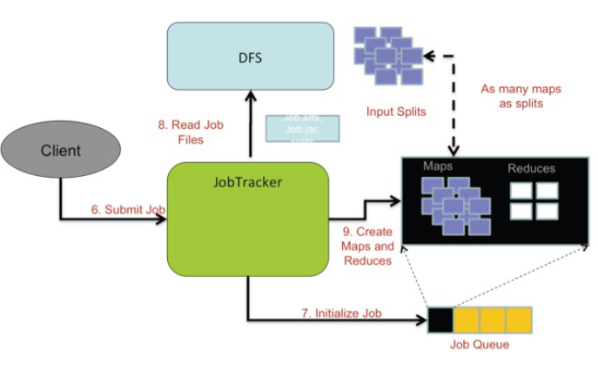
Job Initialization

Slide 67
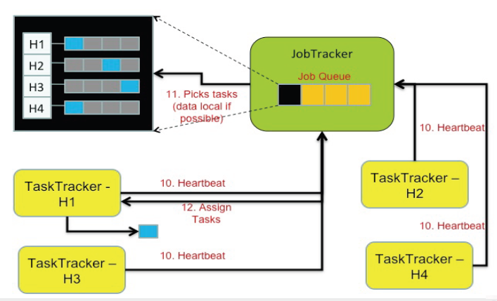
Job Scheduling

Slide 68
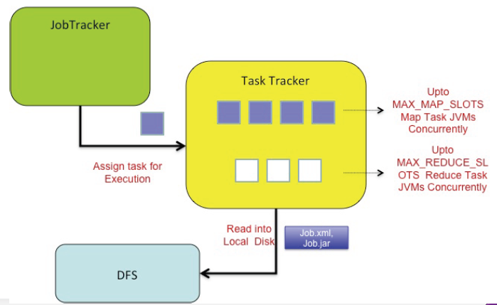
Job Execution (Map Task)

Slide 69
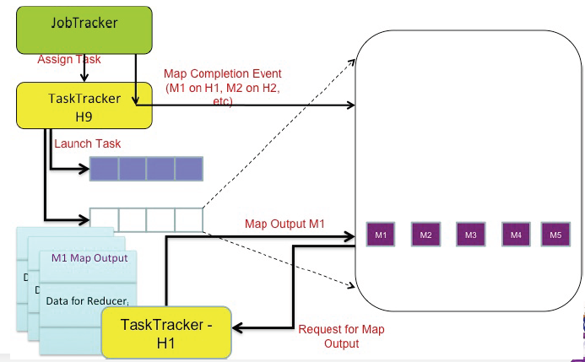
Job Execution (Reduce Task)

Slide 70
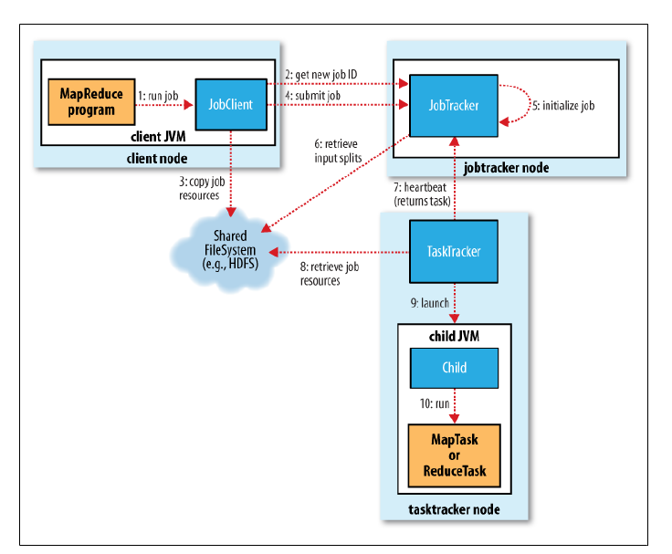
How Hadoop runs a MapReduce job?

Slide 71
Challenges
Cheap nodes fail, especially if you have many
Mean time between failures for 1 node = 3 years
Mean time between failures for 1000 nodes = 1 day
Solution: Build fault-tolerance into system
Commodity network = low bandwidth
Solution: Push computation to the data
Programming distributed systems is hard
Solution: Data-parallel programming model: users write “map” & “reduce” functions, system distributes work and handles faults

Slide 72
Additional Slides

Slide 73
How Hadoop runs a MapReduce job?

Slide 74
Job Submission Process
• Asks the jobtracker for a new job ID (by calling getNewJobId() on JobTracker) (step 2).
• Checks the output specification of the job. For example, if the output directory has not been specified or it already exists, the job is not submitted and an error is thrown to the MapReduce program.
• Computes the input splits for the job. If the splits cannot be computed, because the input paths don’t exist, for example, then the job is not submitted and an error is thrown to the MapReduce program.

Slide 75
Job Submission Process contd.
• Copies the resources needed to run the job, including the job JAR file, the configuration file, and the computed input splits, to the jobtracker’s filesystem in a directory named after the job ID.
The job JAR is copied with a high replication factor (defaults value 10) so that there are lots of copies across the cluster for the tasktrackers to access when they run tasks for the job (step 3).
Tells the jobtracker that the job is ready for execution (by calling submitJob() on JobTracker) (step 4)

Slide 76
Job Submission Process contd.
When the JobTracker receives a call to its submitJob() method, it puts it into an internal queue from where the job scheduler will pick it up and initialize it.
Initialization involves creating an object to represent the job being run, which encapsulates its tasks, and bookkeeping information to keep track of the tasks’ status and progress (step 5).

Slide 77
Job Submission Process contd.
To create the list of tasks to run, the job scheduler first retrieves the input splits computed by the client from the shared filesystem (step 6).
It then creates one map task for each split and as many reduce tasks as configured.

Slide 78
Job Assignment Process
Task assignment:
The task trackers send heartbeat messages to indicate they are alive. They also transmit their status (free to perform a task) as part of the heartbeat.
The Jobtracker will allocate it a task, which it communicates to the tasktracker using the heartbeat return value (step 7).
To ensure data locality, the job tracker assigns that task for which the data (inputsplit) is available very close to the task tracker – data-local, rack-local, others

Slide 79
Job Execution Process
Task execution:
Copy the job JAR from the shared filesystem to the tasktracker’s file-system. Also copy any files needed from the distributed cache
Create a local working directory for the task, and un-jar the contents of the JAR into this directory.
Create an instance of TaskRunner to run the task.
TaskRunner launches a new Java Virtual Machine (step 9) to run each task in (step 10), so that any bugs in the user-defined map and reduce functions don’t affect the tasktracker (by causing it to crash or hang).
The child process communicates with its parent through the umbilical interface. This way it informs the parent of the task’s progress every few seconds until the task is complete.

Slide 80
Summary
Process flow in MapReduce
Motivation for Programming Paradigm
MapReduce
MapReduce Operational Steps
Twister : Iterative MapReduce
Hadoop
HDFS Architecture
Read and Write Operations in HDFS
MapReduce Architecture in Hadoop
Running a job in Hadoop
Challenges

Slide 81
References
Hadoop: http://hadoop.apache.org/core/
http://hadoop.apache.org/docs/r1.2.1/hdfs_design.html
https://www.packtpub.com/books/content/hdfs-and-mapreduce

Slide 82
Thank You

